Slide 1
Family Medicine:
The Multidisciplinary Team in Primary Care
Year 2
Centre for Medical Education
General Practice Experience
2020/2021

Slide 2
Aim of session
To introduce students to the multidisciplinary team in Primary Care and consider how they meet patients’ needs

Slide 3
Background of Multidisciplinary teams
Not a new concept
Increased blurring of roles
Not confined to physical space e.g. the GP practice
Notes:
GPs have always worked with other disciplines now an increased emphasis and new initiatives
Blurring of roles – nurses, pharmacists taking on roles traditionally carried out by doctors
Re physical space – come back to this in next slide

Slide 4
Where do Primary Care teams work?
Notes:
I have left this blank deliberately, suggestion on next slide
This is an interactice moment and as per the teaching plan, you can decide whether you do this just by students chipping in on their mics, using the chat function or even breakout rooms if you are comfortable with this.

Slide 5
Where do Primary Care teams work?
Notes:
Obvious thing – PC centres, OOHs, patient homes, in the community
But think more broadly (bit like where consultations take place) - in community pharmacies, in baby clinics
Also worth mentioning how different GP practices can be – small single handed practices in a converted terrace house to large multipurpose health Centres, in shopping centres

Slide 6
Brainstorming the MDT
Notes:
I have left this blank deliberately, suggestion on next slide
Often there are students with personal experience of working in primary care and they can share this with students – worked as GP receptionsts, parents who work in primary care or even graduate students who are working at the weekend as locum pharmacists
Also important to say that often people's roles fall into different categories – the admin person who doubles as a HCA
Over the next few slides I have divided the team into Clinical (in practice), Admin/mangerial ( in practice) and Outside the GP practice

Slide 7
Clinical (in the practice)
General Practitioners (Principals, salaried, locum, trainees)
Nurses (Nurse Practitioners, Practice Nurses, Treatment room Nurses)
Health care assistants
Pharmacists
CBT therapists
Physiotherapists
Social workers
?Medical students
Notes:
Opportunity to describe the different types of GP
I will have forgotten some – please add
Examples of what happens in your practice – students will love to hear about these – Asthma clinics, Minor op clinics, baby clinics etc

Slide 8
Admin/Managerial staff
Managers – Practice, Business etc
Admin staff
Notes:
Might be worth mentioning that in some practices, one of the GPs may take on a lot of the business side of the practice
This is a great opportunity to talk about the important role of the GP receptionsts, they have been increasingly in the spot light with the shift to telephone triage
“I’m keen to stress that our reception staff are highly trained to deal with these queries and are bound by a professional code of practice whereby all information is confidential. They will only ask about necessary details so that the doctor, nurse or pharmacist can prioritise your call.” Laurence Dornans's (RCGP) remarks on this BMA press release https://www.bma.org.uk/bma-media-centre/new-ways-of-working-but-gp-practices-still-open-protecting-and-caring

Slide 9
The wider community team
District Nurses
Health visitor
Midwife
Dentists
Community pharmacists
Community OTs, physios, SLT etc
Social workers, approved social workers
Opticians
CPNs
Hairdressers …
Notes:
Important to talk about the role of DNs and their relationship with the practice
Recognise that some practices have MW in practice
AGain feel free to add
Students will love your examples on this – discussions with comm pharmacists, ASWs
I am being facetious with hairdressers, you can delete if you want!

Slide 10
An example of the multidisciplinary team involvement with a patient...
Notes:
I suggest here you describe an example where the broader MDT meets the needs of a patient with a chronic health condition. The example I would use would be diabetic clinics – these of course will vary practice to practice and will be different at the moment but it might be worth thinking precovid
Consider the "patient experience" for this patient

Slide 11
The "MDT" model in NI
Notes:
The next slide is the brochure which might be a good way to explain what it is
Explain if your practice is involved at the moment

Slide 12
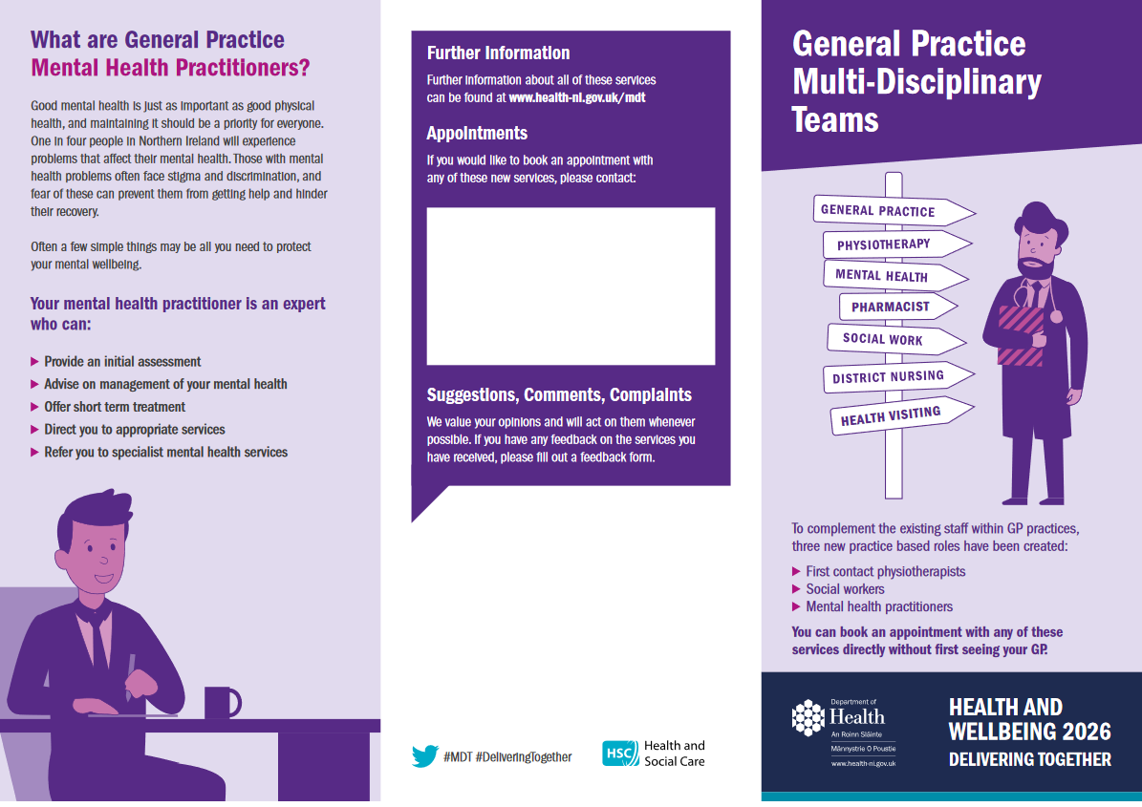

Slide 13
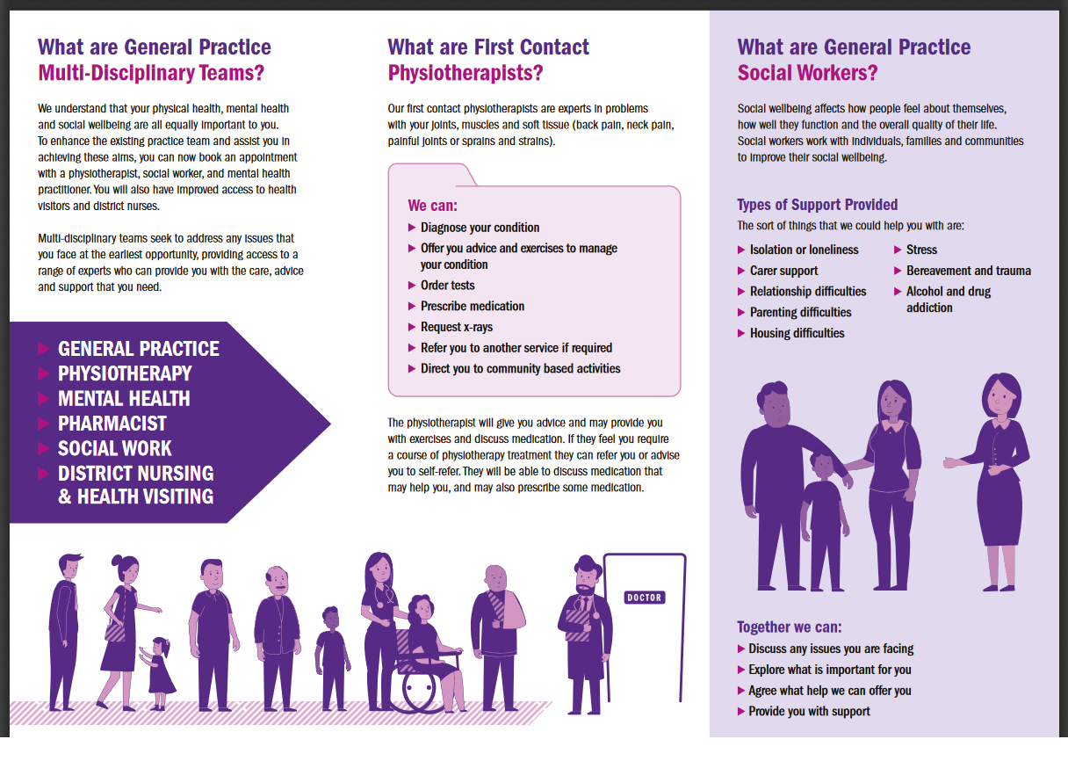

Slide 14
The "MDT" model in NI
Patients may be seen by other healthcare professionals at first contact e.g. physiotherapists, social workers
Idea is GPs' time will therefore be used more effectively
Increased focus on prevention and early intervention reducing the need for onward referral
Notes:
If you have any experience with the model in your practice, you can describe to the students

Slide 15
Role out of the MDT
What are the advantages for patients?
Can the students anticipate any barriers to rolling out this model fully?
Notes:
Students should be able to come up with plenty of advantages for patients (I hope)
Things that might come up for barriers – money to support the service diverted from core Primary Care!! Loss of GP roles? Loss of expertise for GPs?
Space in practice for all these practitioners?
Equal access to the model for all practices?
Patient "choice" - wanting to see a GP – discuss

Slide 16
Aim
To introduce students to the multi-disciplinary team in Primary Care and consider how they meet patients’ needs

