Slide 1
Introduction to Family Medicine
Tutors’ Meeting
9th September 2020

Slide 2
For attendance
(and SUMDE payment)
Please put your name and practice code in the chat!
Notes:
Nigel

Slide 3
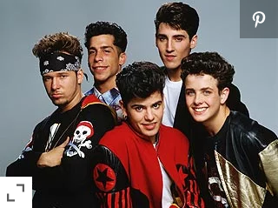

Slide 4


Slide 5
For attendance
(and SUMDE payment)
Please put your name and practice code in the chat!

Slide 6
Agenda
General housekeeping
Year 2 – General Practice Experience
Year 1 – Family Attachment
Technical Support “ok, but how will I
actually do that?”

Slide 7
GMC feedback during
QUB visit 2017
“Students from all year groups praised the early clinical contact they received, particularly citing the Family Attachment.”

Slide 8
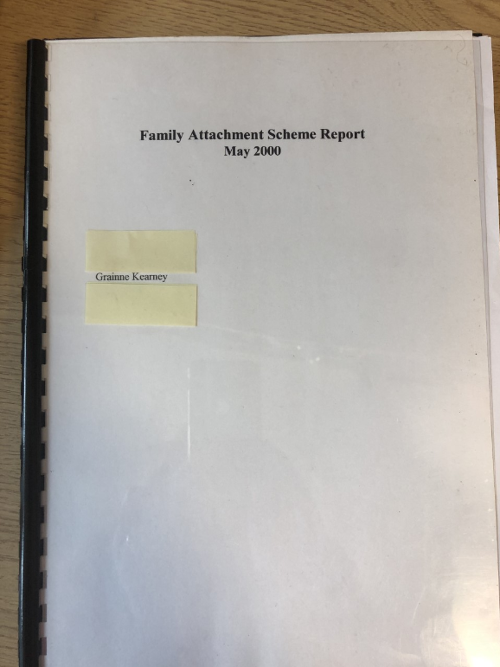

Slide 9


Slide 10


Slide 11
Year 1 dates
Tuesdays Thursdays
Session 1 6/10 8/10
Session 2 10/11 2/11
Session 3 24/11 26/11
Session 4 26/1 or 2/2 28/1
Session 5 2/3 or 9/3 4/3

Slide 12
Year 2 dates
Tuesdays Thursdays
Session 1 QUB intro QUB intro
Session 2 20/10 or 3/11 22/10 or 5/11
Session 3 1/12 or 8/12 3/12 or 10/12
Session 4 23/2 23/2 (Tues)
Session 5 18/3 (Thurs) 18/3

Slide 13
For attendance
(and SUMDE payment)
Please put your name and practice code in the chat!

Slide 14
Introduction to Family Medicine
Year 1 – the Family Attachment Scheme
Year 2 – General Practice Experience

Slide 15
Agenda
General housekeeping
Year 2 – General Practice Experience
Year 1 – Family Attachment
Technical Support “ok, but how will I
actually do that?”

Slide 16
General Housekeeping
Tutor resources
Case Based Learning
Student attendance
Challenges (other than the elephants in the room!)

Slide 17
Tutor’s Guide
Introduction to Family Medicine
A course for first and second year medical students
Year 1: The Family Attachment Scheme
Year 2: General Practice Experience
Tutor Guide 2020-21

Slide 18
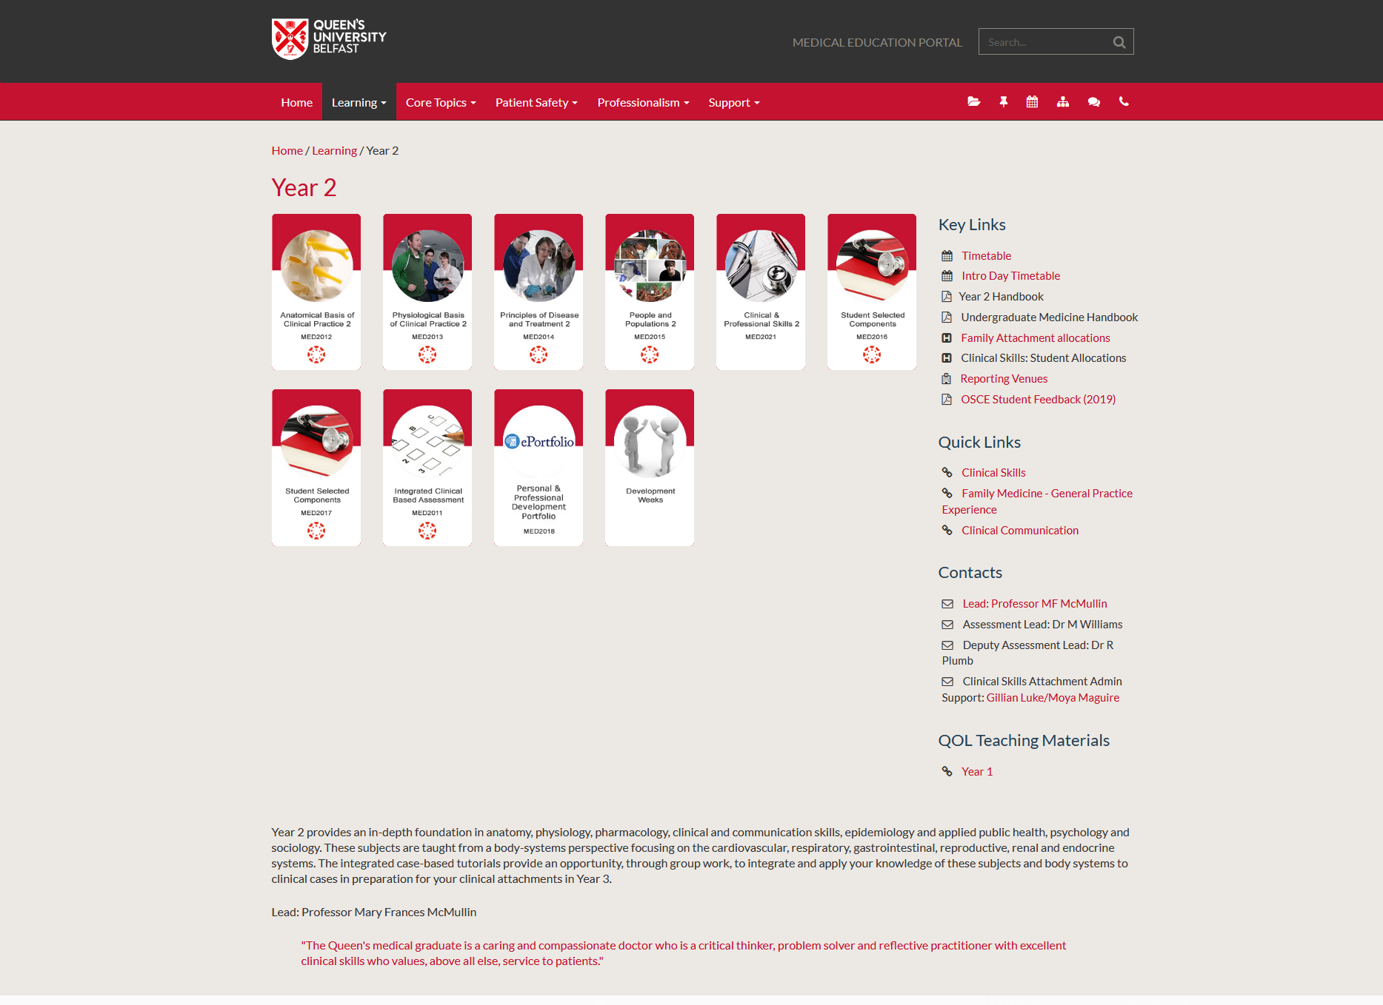
Portal

Slide 19
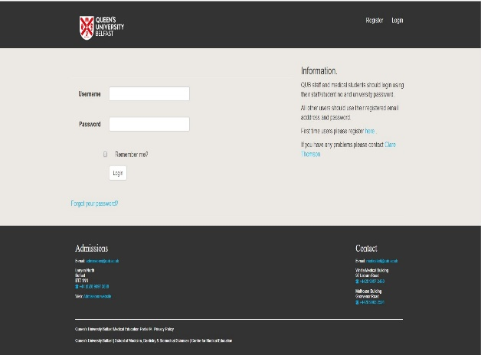
Access to the Portal

Slide 20

https://www.med.qub.ac.uk/wp-gp/

Slide 21

C25 roll out
Phases – Foundation Y1-2, Immersion Y3-4 / Preparation Y5
Vertical Themes – GCAT
Integrated systems based teaching year 1+2
New quality improvement project year 4
Case based learning year 1-4
Longitudinal clerkships year 3 and 4
More time in general practice – 25%
Assessment – Progress testing

Slide 22
Years 1 and 2
Integrated systems based teaching – biomedical, behavioural, public health, clinical science
Foundations module
5 systems modules:
  Cardiovascular / Respiratory / Haematology
  Musculoskeletal 1
  Gastrointestinal / Renal / Endocrine / Reproductive
  Neurological (includes mental health)
  Musculoskeletal 2 (includes skin)
Retain cadaveric dissection and early clinical contact / FAMILY ATTACHMENT
Case-based learning

Slide 23
Case based learning
Their patient/family is their:
Real world, unique case

Slide 24
Student attendance
100% expected – if not let us know
Repeating student also 100% (do not have to repeat assessments)

Slide 25
Challenges …
Rogue dates in Y2
Student numbers
No student feedback this year

Slide 26
For attendance
(and SUMDE payment)
Please put your name and practice code in the chat!

Slide 27
Agenda
General housekeeping
Year 2 – General Practice Experience
Year 1 – Family Attachment
Technical Support “ok, but how will I
actually do that?”

Slide 28
Year 2 – General Practice Experience 19/20
5 tutorials in practice
Session 1 – Introduction and video
Session 5 – Round up and Assessment
Assessed on
Individual contribution to tutorials
Quality of log book entries
Quality of end course presentation

Slide 29
Year 2 – General Practice Experience 20/21
4 tutorials over VC (see tutor’s guide)
Session 1 – QUB Introduction
Session 5 – Round up and Assessment
Assessed on
Individual Contribution to tutorials
NO log book
Quality of end course presentation

Slide 30
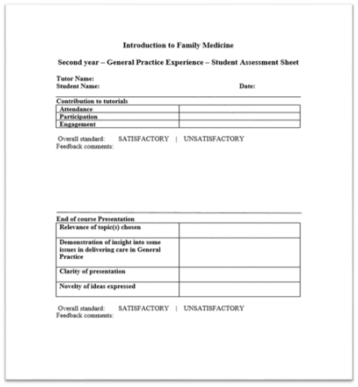
Student Assessment Sheet (session 5)

Slide 31
Year 2 – General Practice Experience
Sessions 2, 3 and 4 in 19/20
Sitting in with the GP
Student consulting
Sitting in with a Practice Nurse
Sitting in with a Practice Pharmacist
Talk to a CBT therapist
Spend time at reception
Speak to the Practice Manager
Expert patient
Reconnecting with families (where possible)

Slide 32
Year 2 – General Practice Experience Tutorial 2-4
Modes of consultation
The MDT in Primary Care
The “work” of a Patient

Slide 33
Year 2 – General Practice Experience Tutorial 2
Modes of consultation
Aim of Session
Background
Brainstorm the different modes of consultation
Consider each in turn
F2F
Telephone (triage v consult)
Video
Advantages
Pitfalls
Who might struggle
Safety netting
Zoom FA?
Revisit Aim

Slide 34
Year 2 – General Practice Experience Tutorial 3
The MDT in Primary Care
Aim of Session
Background
Brainstorming the MDT
Clinical
Admin/Managerial
The wider team
MDT initiative
Revisit aim

Slide 35
Year 2 – General Practice Experience Tutorial 4
The work of a “Patient”
Part 1 – challenge the students to think about what a patient has to do to manage their health
Part 2 – hear about this “work” directly from a patient

Slide 36
For attendance
(and SUMDE payment)
Please put your name and practice code in the chat!

Slide 37
Agenda
General housekeeping
Year 2 – General Practice Experience
Year 1 – Family Attachment
Technical Support “ok, but how will I
actually do that?”

Slide 38
Year 1 – Family Attachment 19/20
5 tutorials in practice
Visits to patients/families
Assessment – joint portfolio with individual reflective piece

Slide 39
Year 1 – Family Attachment 20/21
5 tutorials over VC
“Contacts” with patients/families
Assessment – joint portfolio with individual reflective piece
Main differences
Choosing patient/families (numbers)
Video conferencing (later)
First “contact” (later)
?Tour of practice
Video on portal to show students
Patient notes

Slide 40
Year 1 – Family Attachment 20/21
Choosing patients/families
Need to be able to use VC (or be aided) think when you contact a patient
Happy to be contacted independent of you
Happy to give over their email and their phone number for backup
Available on date of second tutorial for introduction (then 2+ times to be agreed with the students)
Neven chosen due to their “disease” anyway
First tutorial October, second November
Assurance re security of Zoom
Group size can be bigger if needed
Suggest adding repeating student to an existing duo or trio

Slide 41
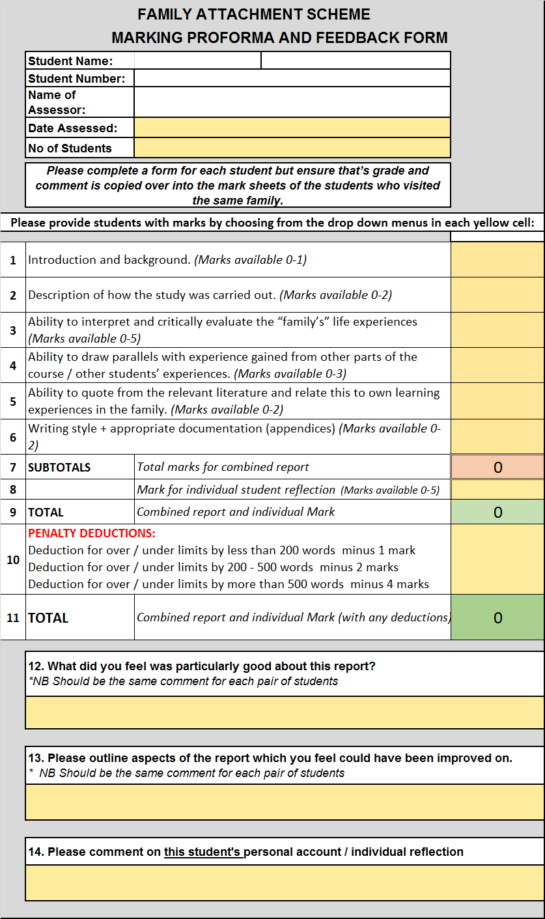

Slide 42
For attendance
(and SUMDE payment)
Please put your name and practice code in the chat!

Slide 43
Agenda
General housekeeping
Year 2 – General Practice Experience
Year 1 – Family Attachment
Technical Support “ok, but how will I
actually do that?”

Slide 44
Technical aspects
For both Y1 and Y2
Zoom licenses/web cams
Need to set up the 5 tutorials for each year and send the link to your student group in advance
We will provide support if needed for this

Slide 45
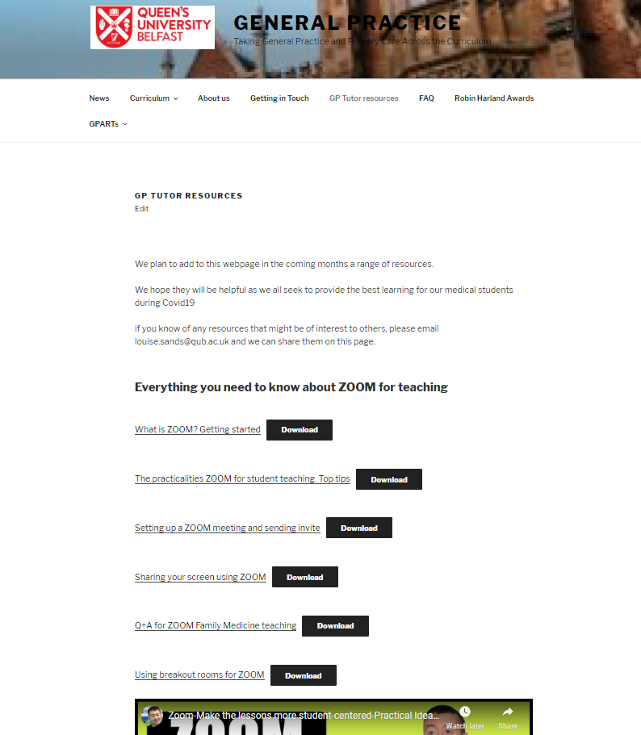
VC resources

Slide 46
Family contact (Y1)
Probably even more necessary this year to personally introduce the students
Address with students at the end of Tutorial 1
Students to set up all patient meetings including the intro
Give them the time and the patient’s email address at tutorial 1 (next slide) for them to set up in advance
All detailed in the study guide

Slide 47
Suggested format Tutorial 2
The equivalent of the door step intro
2pm all group tutorial (already set up by tutor)
2-230 preparing the students, all leave at 230
240pm intro for student group 1, patient A and tutor – tutor leaves after 5 min
3pm intro for student group 2, patient B and tutor – tutor leaves after 5 mins
320pm - intro for student group 3, patient C and tutor – tutor leaves after 5 mins
345pm – students and tutor reconvene on original link
During this meet – students and patients plan next contact (not with tutor)

Slide 48
Feedback from students
Helped me focus on patients as people

Slide 49
For attendance
(and SUMDE payment)
Please put your name and practice code in the chat!

Slide 50
Introduction to Family Medicine
Final Remarks + Thanks!
Contact g.kearney@qub.ac.uk
gpadmin.@qub.ac.uk
https://www.med.qub.ac.uk/wp-gp/

